Slide 1
Adult Data Collection
Cory Wellbrock, Jean Thompson, Trevor Kahl
Notes:
TREVOR

Slide 2
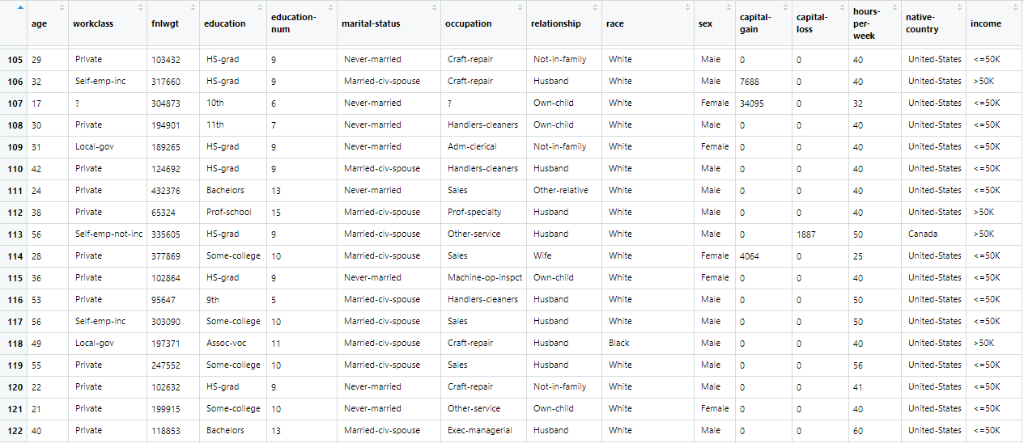
Adult Data Set
What is the data set?
What did we want to know from the data?
What could we reasonably look at to predict an outcome?
Notes:
TREVOR
What is this data set?
-Wanted to choose a data set with easily understandable variables to go more deep into analysis
-Adult census data from 1994
-Variables consist of ages, social class, martial status, occupations, relationship (the unit’s role in a family), race, sex, capital gain, capital loss, hours per week work, native country, and a binomial variable for income
-We mainly wanted to investigate what factors from census data contributed to the likelihood of someone earning more or less than 50K.
-How can we determine most effectively if someone makes over 50,000.
-What are indicators that we can use to best predict this? Education, relationship, native country, etc?

Slide 3
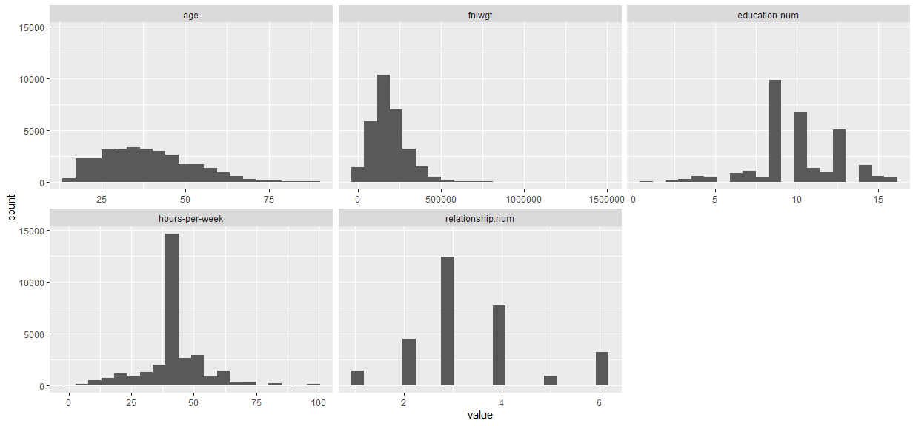
Data Summary
Notes:
TREVOR
Discuss our data spread above
Means:
Age: 38
Education Num: 10 = some college
Hours per week: 40
Relationship Num: 3 = Husband or wife, so married
Workclass: most = private, least = without-pay or Federal-gov
Race: most = white: 25,933, least = American Indian: 286
Sex: Female = 9782, Male = 20380
Native-Country: Most = USA, Least: Canada
Income: <=50k: 22654, >50k: 7508

Slide 4
Data Cleanup
Data Before/After:
Began with approximately 33,000 observations
After cleanup, 30,162 observations remained
Clean-up Actions
Named columns
Removed capital-gain and capital-loss columns
Transformed question marks to NA, then removed NA values (around 4,000 total spanning three columns)
Removed leading whitespace
Restored data structure
Transformed variables to binomial for ease of calculation
Notes:
CORY
Why did we cleanup what we cleaned up?
Original data didn’t contain column names, so we pulled that for ease of data viewing
Two columns we deemed un-useful, so we removed them to clear up the clutter
Three columns contained question marks (I.E. incomplete/empty data). These were set to NA and then removed via the na.omit() function
This removed roughly 4,200 rows leaving 30,162 as ‘clean data’
Virtually every column contained leading whitespace, which complicated mapping and other data evaluation
A block of code was inserted to trim the whitespace via the trimws() function
trimws() sets the remaining data as character strings, so a separate block of code was inserted to restore the original data structure
-Words -> factors and manipulating the data (ex. income to binomial 0 and 1 variable)

Slide 5
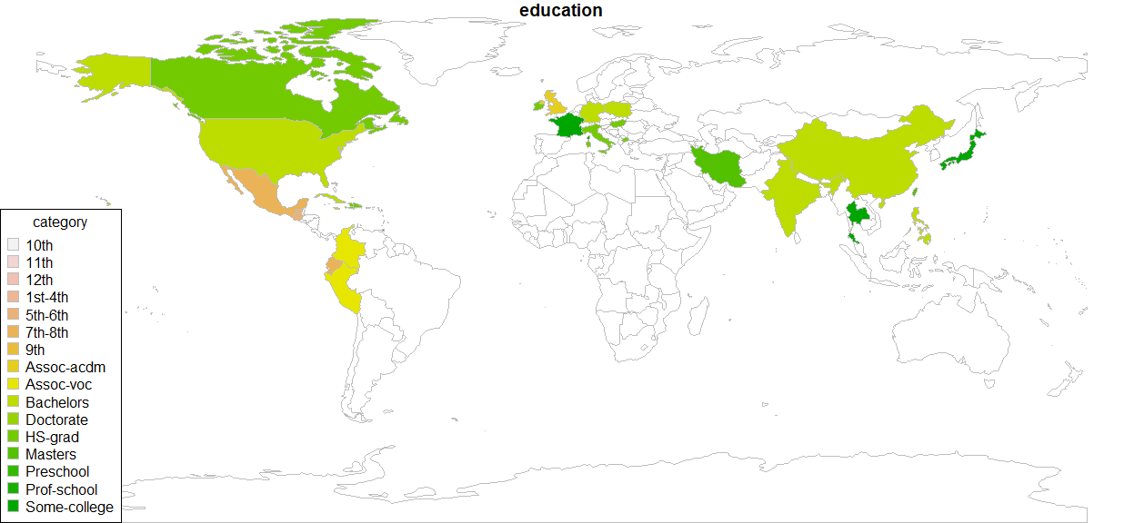
World Map
Notes:
TREVOR
Discuss use case of our world map visual
Positives are it shows us at a glance our education at a glance by country. Visually appealing
Negatives are that it doesn’t show contextually how much we pulled from each country, also shows the disparity of the data that was given to us. We would suggest that more data be pulled from other countries to most effectively show best results

Slide 6
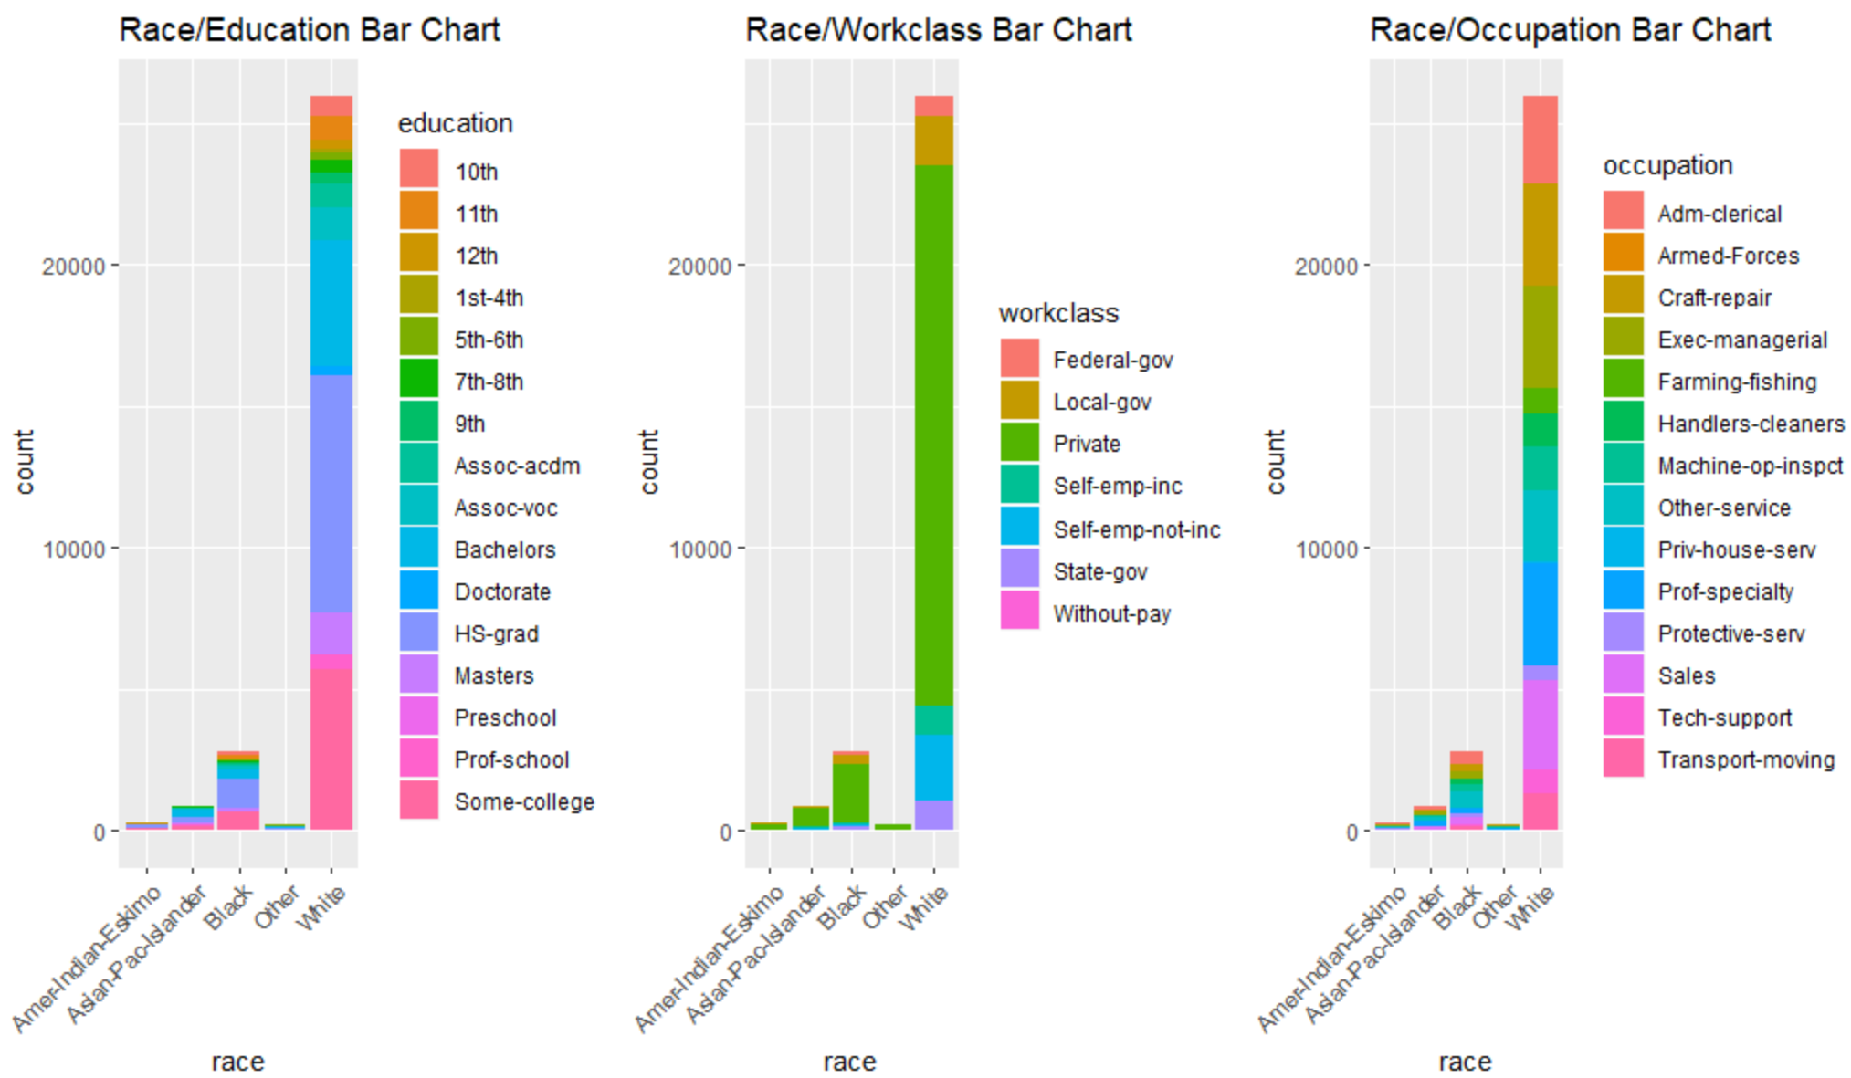
Race Bar Charts
Notes:
CORY

Slide 7
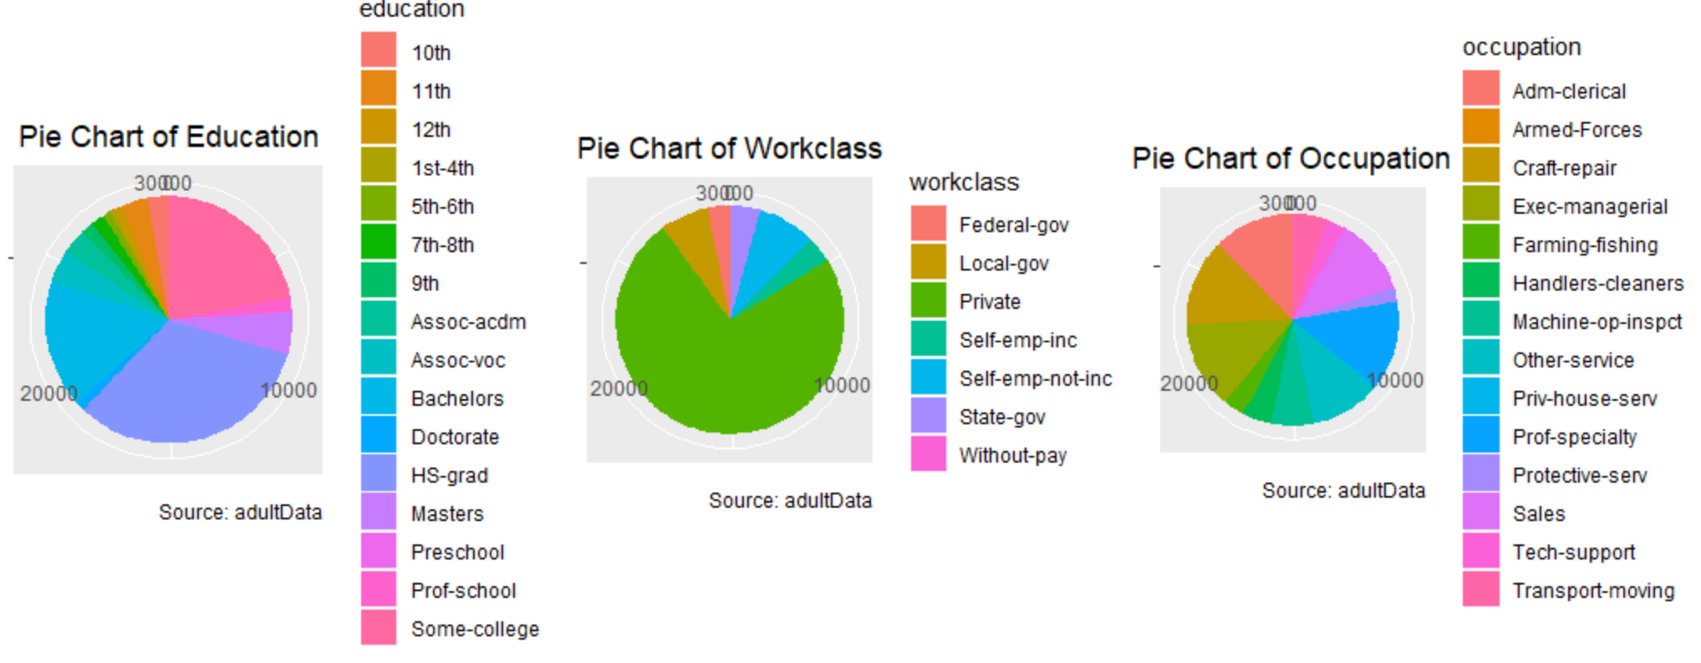
Pie charts
Notes:
CORY

Slide 8
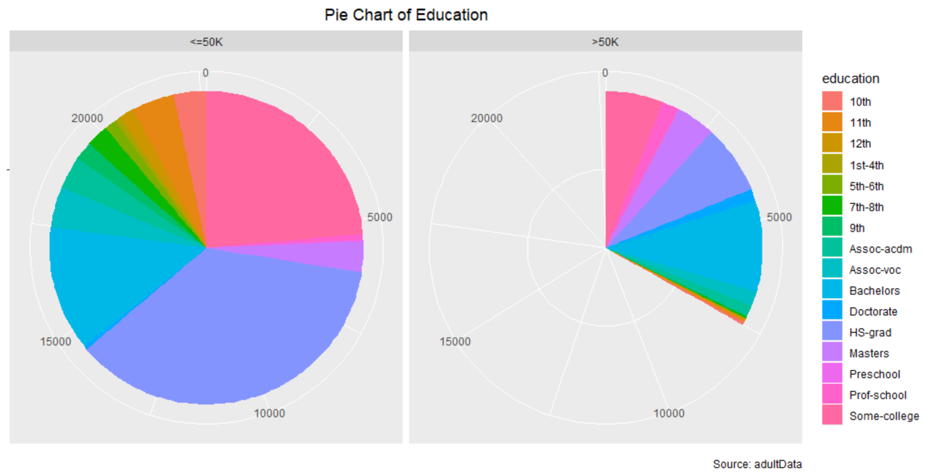
Pie Chart: Income by Education
Notes:
CORY

Slide 9
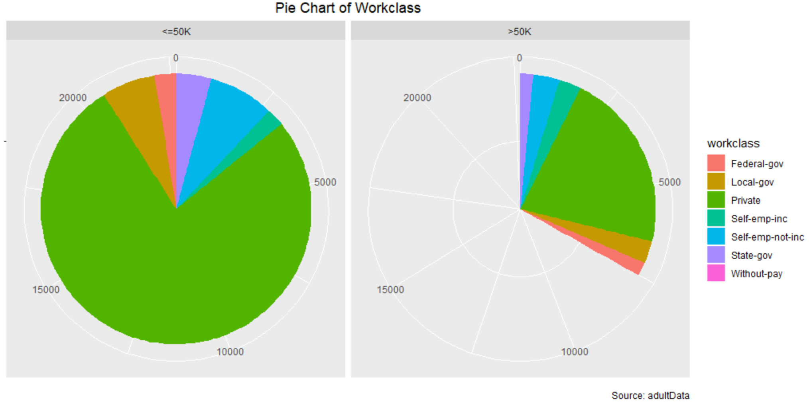
Pie Chart: Income by Workclass
Notes:
CORY

Slide 10
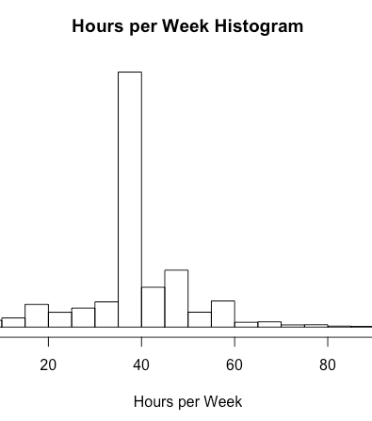
Hours Worked per Week
This graph breaks down the total workweek hours for all our observations
As we can see, most respondents work our typical 40 hour week week.
Notes:
JEAN

Slide 11
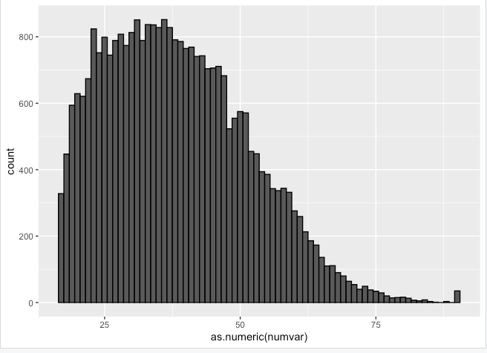
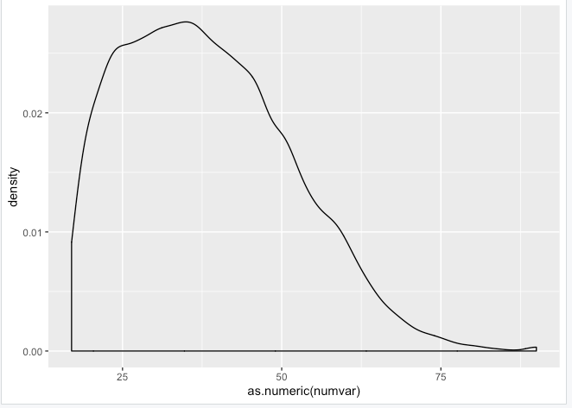
Age Histograms
Notes:
JEAN
-commentary on skewness to the right for our ages

Slide 12
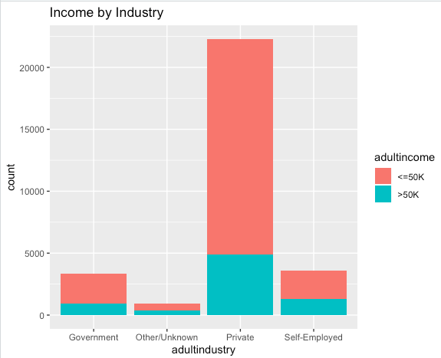
Income by Industry
Per this binomial diagram percentage breakup of income by industry, of each industry, if you are self employed you have the greatest proportionate chance of having an income over 50K.
Notes:
JEAN
Our analysis combined the multiple industry categories into streamlined simplistic industries.
This analysis broke up the percentage of the employees making X amount of income by each industry. Proportionately, self employed had the highest percentage.
#results combined with count
# adultindustry adultincome count
#1 Other/Unknown <=50K 0
#2 Other/Unknown >50K 0
#3 Other/Unknown/Unknown <=50K 2393
#4 Other/Unknown/Unknown >50K 953
#5 Private <=50K 17410
#6 Private >50K 4876
#7 Self-Employed <=50K 2259
#8 Self-Employed >50K 1314

Slide 13
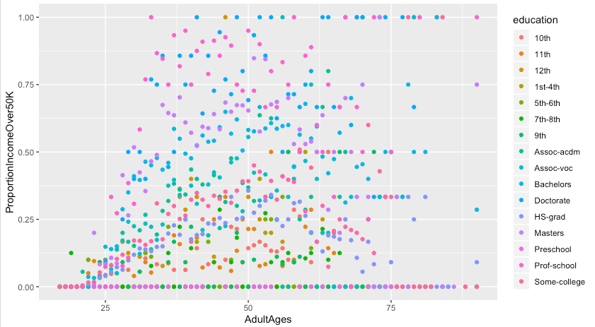
Proportionate Income by Age and Education

Slide 14
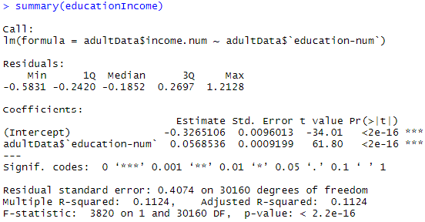
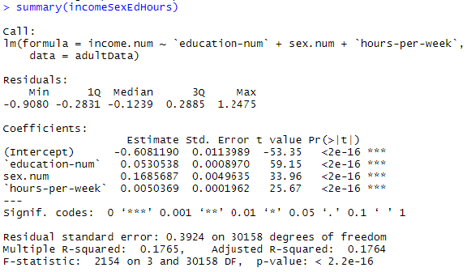
Linear Models
Initial Models
First, we wanted to see if education was a large and significant role to predicting. Found to be significant but not very informative to giving us Income.
When we added more into our model, we saw more significance to the model and inputs.
Notes:
TREVOR

Slide 15
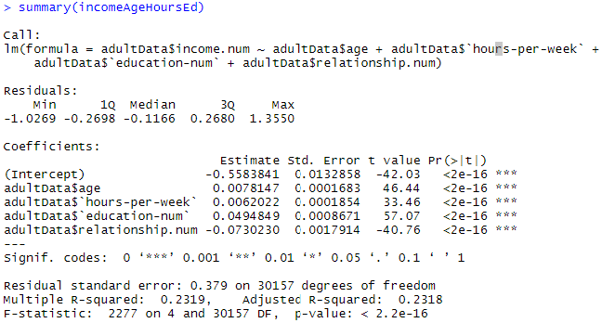
Linear Models
Most Effective LM
After seeing that adding inputs positively showed us a better effect on our outcome we decided to add all categorical values we had.
Still showing strong significance in the values but not as high an effective value from our inputs to our overall outcome of Income
Notes:
TREVOR

Slide 16
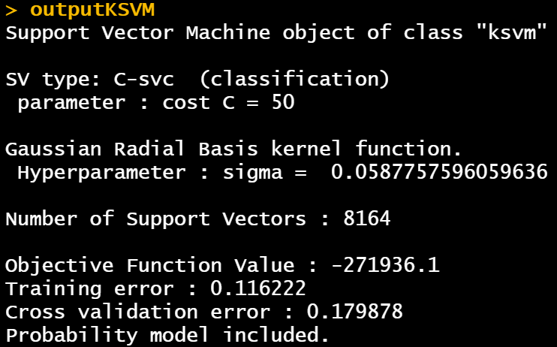
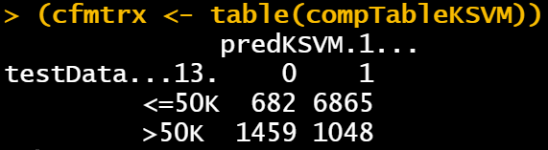
KSVM
This KSVM model yielded an 83% correct prediction rate
Notes:
CORY
Talk about:
Costs and cross numbers
Training error
Cross validation error
Confusion matrix
83% correct prediction rate which was surprising as all variables were included
Actually got a worse percentage rate when configuring a model with select variables that one would think would have an impact

Slide 17
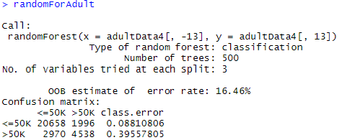
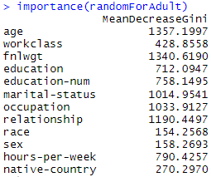
RandomForest
Our model shows that we can currently predict our outcome of Income with an error rate of 16.46%
Most important factors are age, fnlwgt, and relationship. This will help us determine what to focus on in the future when trying to predict income most effectively
Notes:
TREVOR

Slide 18
Lessons Learned
The data set was heavily skewed to show a certain bias towards certain data types that was collected
Visual tools such as maps can be visually appealing, but it was found that histograms and pie charts we a better representation of the data set that we had on hand
Modeling our data with simple linear models can be prove to be effective but with mostly categorical data we found more complex models such as KSVM and RandomForest to give us our best predictors
Notes:
TREVOR

